Slide 1

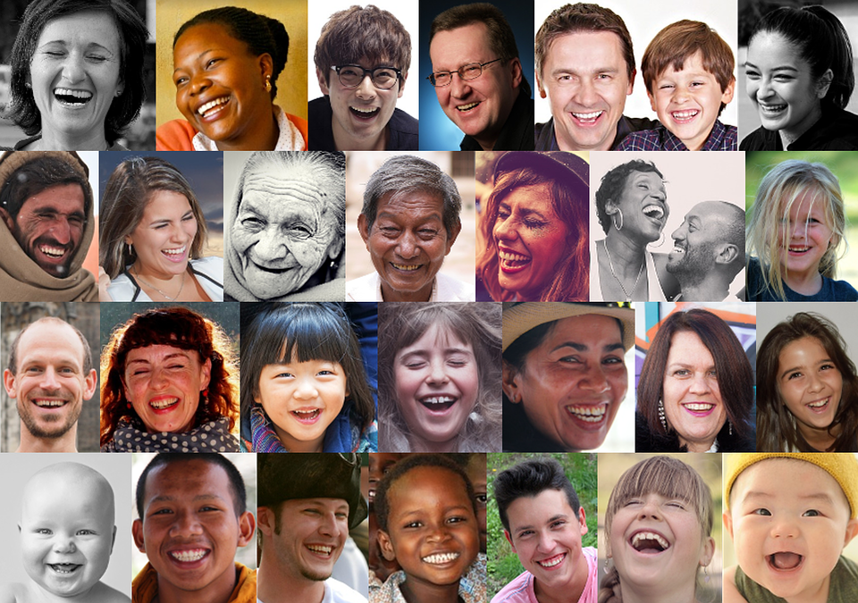
PROBLEM STATEMENT: SMILE DETECTOR
Photo Credit: https://pixabay.com/en/smile-laugh-portrait-close-up-joy-1491429/

Slide 2
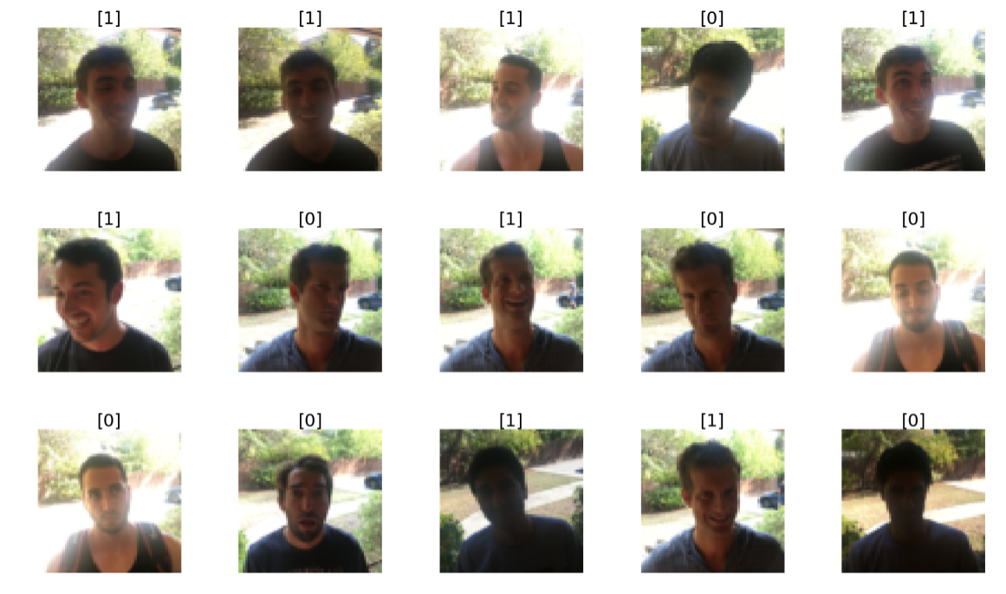
PROBLEM STATEMENT: SMILE DETECTOR
The dataset contains a series of images that can be used to solve the Happy House problem!
We need to build an artificial neural network that can detect smiling faces.
Only smiling people will be allowed to enter the house!
TARGET CLASS
0: NOT SMILING
1: SMILING
IMAGE
Data source: https://www.kaggle.com/iarunava/happy-house-dataset

Slide 3
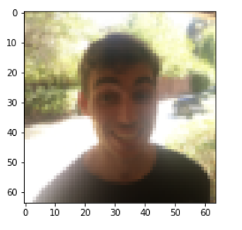
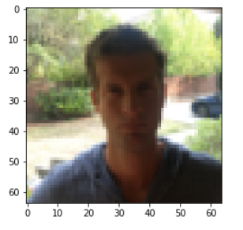
PROBLEM STATEMENT: MACHINE LEARNING TERMS
Smile detector dataset contains 64x64 coloured image with values ranging from 0-255.
'0' represents black and '255' represents white.
INPUT IMAGES
64
CLASSIFIER
TARGET CLASS 1 or 0
64
Happy dataset consists of 750 images
600 training
150 testing
Images are 64x64 pixels (colored)

Slide 4
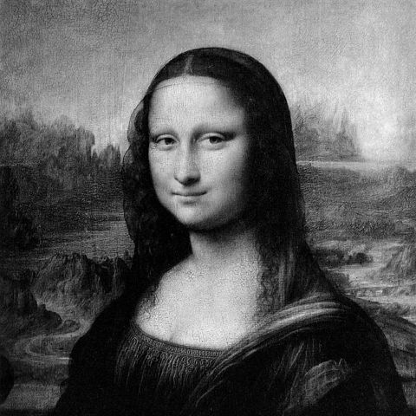
PROBLEM STATEMENT: (REVIEW) WHAT IS AN IMAGE?
A greyscale image is system of 256 tones with values ranging from 0-255.
'0' represents black and '255' represents white.
Numbers in-between represents greys between black and white.
Binary systems use digits '0' and '1‘ where '00000000' for black, to '11111111' for white (8-bit image).
Note: binary value of '11111111' is equal to decimal value of '255‘.
255 | 255 | 255
155 | 155 | 155
0 | 0 | 0
11111111 | 11111111 | 11111111
10011011 | 10011011 | 10011011
00000000 | 00000000 | 00000000

Slide 5
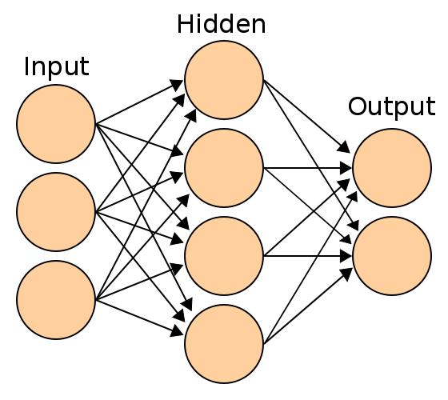
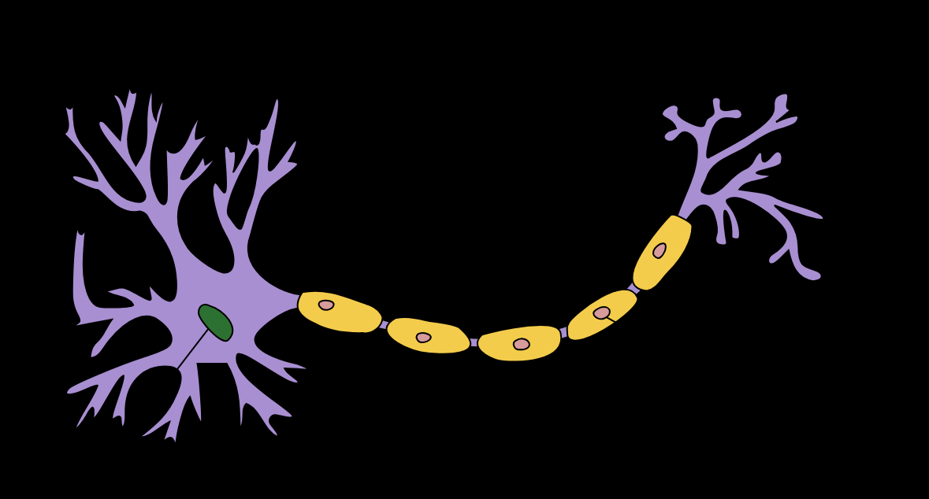
CONVOLUTIONAL NEURAL NETWORK: ARTIFICIAL NEURAL NETWORK BASICS
The neuron collects signals from input channels named dendrites, processes information in its nucleus, and then generates an output in a long thin branch called the axon.
Human learning occurs adaptively by varying the bond strength between these neurons.
Photo Credit: https://commons.wikimedia.org/wiki/File:Artificial_neural_network.svg
Photo Credit: https://commons.wikimedia.org/wiki/File:Neuron_Hand-tuned.svg

Slide 6
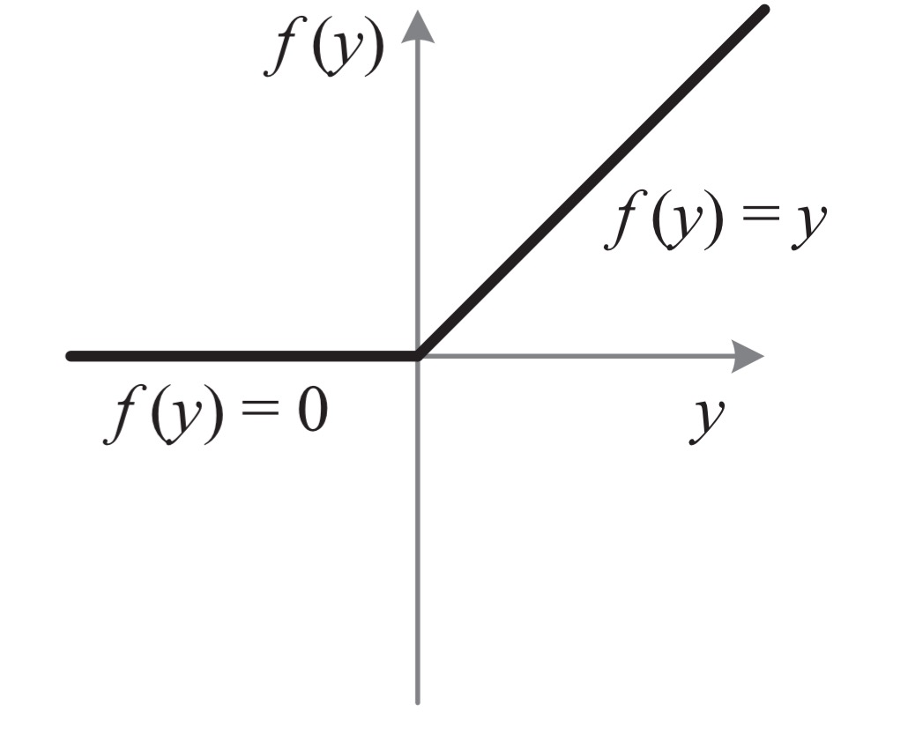
CONVOLUTIONAL NEURAL NETWORK: ENTIRE NETWORK OVERVIEW
TARGET
CLASS:
1: SMILING
0: NOT SMILING
CONVOLUTION
POOLING
FLATTENING
KERNELS/
FEATURE DETECTORS
POOLING FILTERS
CONVOLUTIONAL LAYER
POOLING LAYER (DOWNSAMPLING)
Photo Credit: https://commons.wikimedia.org/wiki/File:Artificial_neural_network.svg
Notes:
Add a full neural network at the end
Feature detectors are also trained besides the weights
Feature detectors are used to preserve the spatial structure information (how pixels are connected to each other),
we cannot simply connect the unique pixels as flat array without having the feature detector layers beforehand
Last layer, we include a sigmoid function to classify the classes

Slide 7
CONVOLUTIONAL NEURAL NETWORK: FEATURE DETECTOR
Convolutions use a kernel matrix to scan a given image and apply a filter to obtain a certain effect.
An image Kernel is a matrix used to apply effects such as blurring and sharpening.
Kernels are used in machine learning for feature extraction to select most important pixels of an image.
Convolution preserves the spatial relationship between pixels.
FEATURE MAPS
KERNELS/
FEATURE DETECTORS

Slide 8
CONVOLUTIONAL NEURAL NETWORK: FEATURE DETECTOR
FEATURE DETECTOR
0 | 1 | 1 | 0 | 1
1 | 0 | 0 | 0 | 1
1 | 1 | 0 | 0 | 0
0 | 1 | 1 | 1 | 0
0 | 0 | 1 | 0 | 1
1 | 0 | 0
0 | 1 | 0
0 | 1 | 0
1
1
1
3
1
1
2
3
1
FEATURE MAP
IMAGE
Live Convolution: http://setosa.io/ev/image-kernels/

Slide 9
CONVOLUTIONAL NEURAL NETWORK: RELU
RELU Layers are used to add non-linearity in the feature map.
It also enhances the sparsity or how scattered the feature map is.
CONVOLUTION
POOLING
FLATTENING
Smiling
Not Smiling
KERNELS/
FEATURE DETECTORS
POOLING FILTERS
CONVOLUTIONAL LAYER
POOLING LAYER (DOWNSAMPLING)
Photo Credit: https://commons.wikimedia.org/wiki/File:Artificial_neural_network.svg
Notes:
Add a full neural network at the end
Feature detectors are also trained besides the weights
Feature detectors are used to preserve the spatial structure information (how pixels are connected to each other),
we cannot simply connect the unique pixels as flat array without having the feature detector layers beforehand
Last layer, we include a sigmoid function to classify the classes

Slide 10
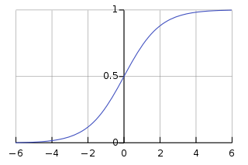
CONVOLUTIONAL NEURAL NETWORK: RELU
RELU Layers are used to add non-linearity in the feature map.
It also enhances the sparsity or how scattered the feature map is.
The gradient of the RELU does not vanish as we increase x compared to the sigmoid function
7 | 10 | -5 | 2 | 1
1 | 0 | 2 | 3 | -6
1 | 17 | -5 | 0 | 0
0 | 1 | 1 | 1 | 0
0 | 0 | -8 | 12 | 1
7 | 10 | 0 | 2 | 1
1 | 0 | 2 | 3 | 0
1 | 17 | 0 | 0 | 0
0 | 1 | 1 | 1 | 0
0 | 0 | 0 | 12 | 1
Photo Credit: https://commons.wikimedia.org/wiki/File:Artificial_neural_network.svg
Notes:
Add a full neural network at the end
Feature detectors are also trained besides the weights
Feature detectors are used to preserve the spatial structure information (how pixels are connected to each other),
we cannot simply connect the unique pixels as flat array without having the feature detector layers beforehand
Last layer, we include a sigmoid function to classify the classes

Slide 11
CONVOLUTIONAL NEURAL NETWORK: MAXPOOLING/FLATTENING
Pooling or down sampling layers are placed after convolutional layers to reduce feature map dimensionality.
This improves the computational efficiency while preserving the features.
Pooling helps the model to generalize by avoiding overfitting. If one of the pixel is shifted, the pooled feature map will still be the same.
Max pooling works by retaining the maximum feature response within a given sample size in a feature map.
Live illustration : http://scs.ryerson.ca/~aharley/vis/conv/flat.html
1 | 1 | 3 | 4
3 | 6 | 2 | 8
3 | 9 | 1 | 0
1 | 3 | 3 | 4
6
MAX POOLING
6
8
FLATTENING
8
9
4
9
2x2
STRIDE = 2
4
Photo Credit: https://commons.wikimedia.org/wiki/File:Artificial_neural_network.svg

Slide 12
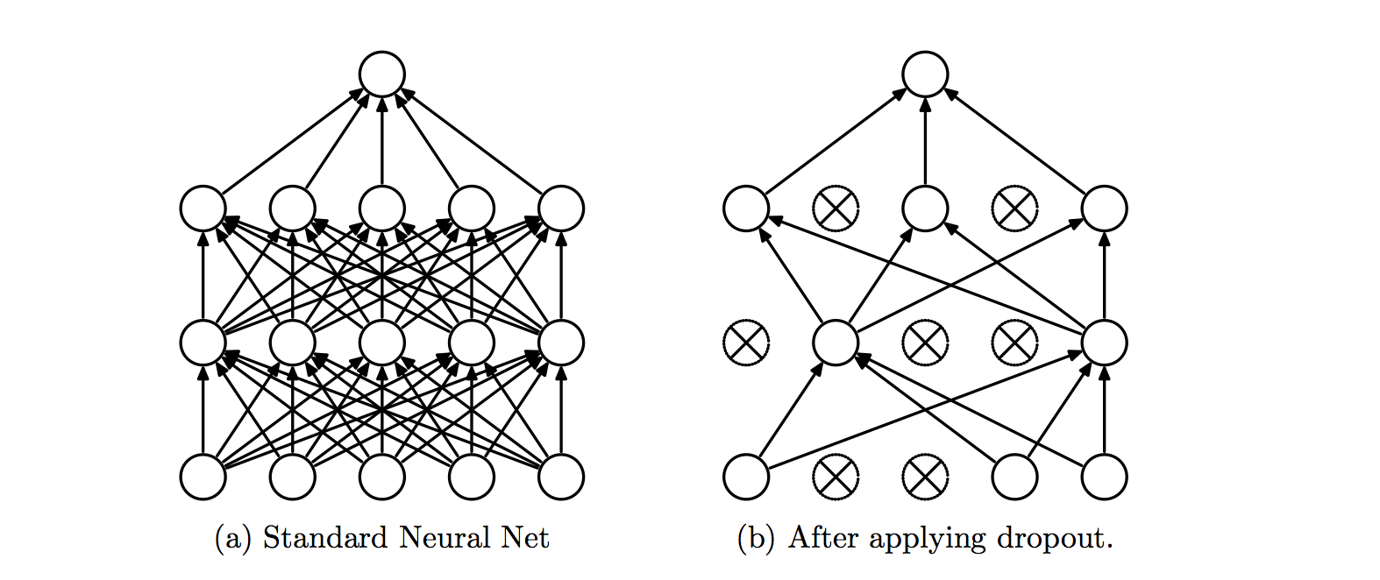
CONVOLUTIONAL NEURAL NETWORK: INCREASE FILTERS/DROPOUT
Improve accuracy by adding more feature detectors/filters or adding a dropout.
Dropout refers to dropping out units in a neural network.
Neurons develop co-dependency amongst each other during training
Dropout is a regularization technique for reducing overfitting in neural networks.
It enables training to occur on several architectures of the neural network
KERNELS/
FEATURE DETECTORS
64 INSTEAD OF 32
https://www.analyticsvidhya.com/blog/2017/05/25-must-know-terms-concepts-for-beginners-in-deep-learning/dropout-2/
Notes:
Add a full neural network at the end
Feature detectors are also trained besides the weights
Feature detectors are used to preserve the spatial structure information (how pixels are connected to each other),
we cannot simply connect the unique pixels as flat array without having the feature detector layers beforehand
Last layer, we include a sigmoid function to classify the classes

